Slide 1
The I-Search Paper
Celebrities and the Charities they support

Slide 2
Instructional Focus
By the end of this presentation, students will
understand the I-Search Project goals.
observe negative media coverage of celebrities.
Recognize the positive contributions of celebrities to society through examination of charities.

Slide 3
FCPS English Indicators
The student will synthesize information from two or more sources to fulfill a self-selected or given purpose. LA.E10.20.0
The student will use various information retrieval sources (traditional and electronic) to obtain information on a self-selected and/or given topic. Electronic sources include automated catalogues, CD-ROM products, and online services like Internet, World-Wide Web, and other. LA.E10.20.04

Slide 4
FCPS Library Media Indicators
The student will understand the library’s role in information access 20.04.a.
The student will utilize safe and appropriate practices when working online LM 20.03

Slide 5
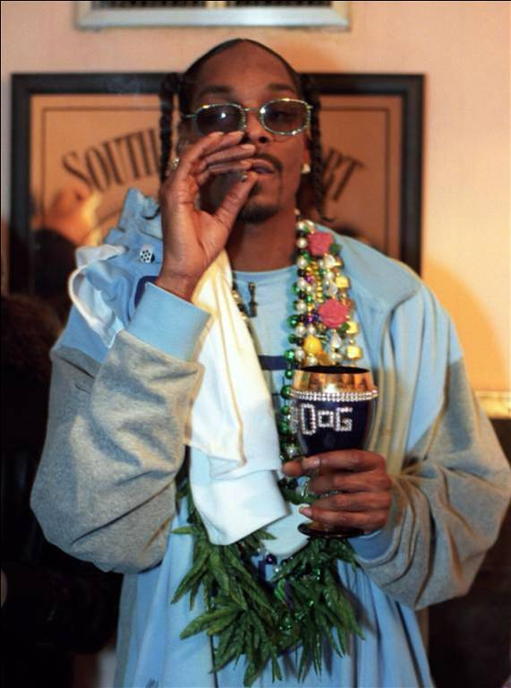
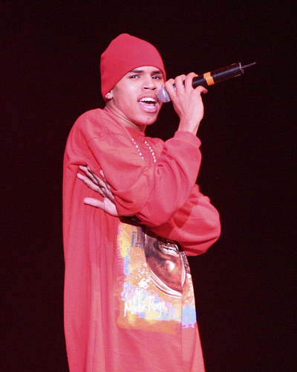
Celebrities in the News Drugs, Sex, and Violence

Slide 6
In the News…
List as many celebrity scandals as you can (this may include politicians)

Slide 7
The Shocking Truth!
Visit the following websites, and read about some of the more shocking scandals in 20th-21st century history:
100 Greatest Scandals
Celebrity Sex Scandals
Hollywood Celebrity Scandals
Posh24

Slide 8
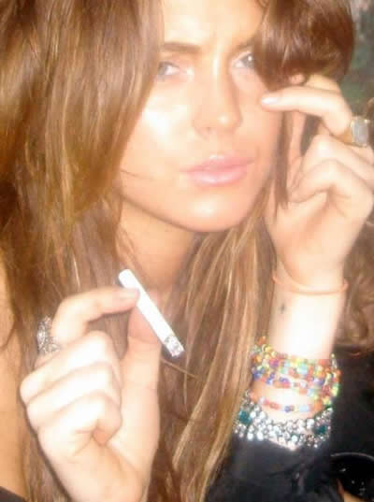
So, Why?
With your partner, brainstorm reasons why the media portrays so many celebrities as bad individuals.
Try to come up with at least 4 reasons.

Slide 9
Scandals in Sports…
Mark McGwire-Federal Steroid Investigation 2005

Slide 10
Scandals in Hollywood…
The Chris Brown/Rihanna Scandal 2009

Slide 11
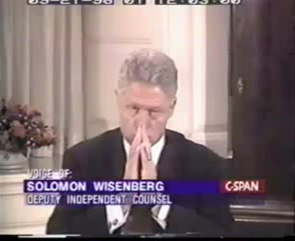
Even…Scandals in the White House
Bill Clinton Testimony During Lewinsky Trial 1998

Slide 12
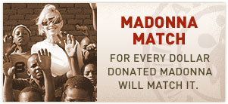
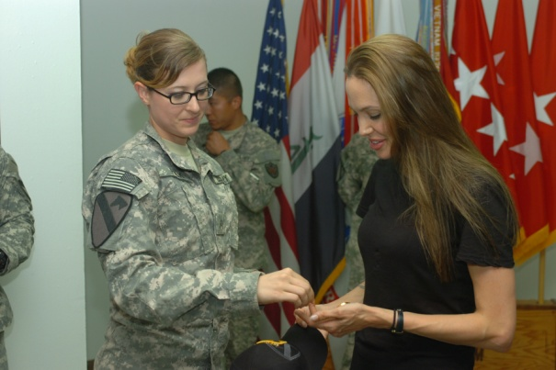
Celebrities Give Back
The World of Celebrity Giving

Slide 13
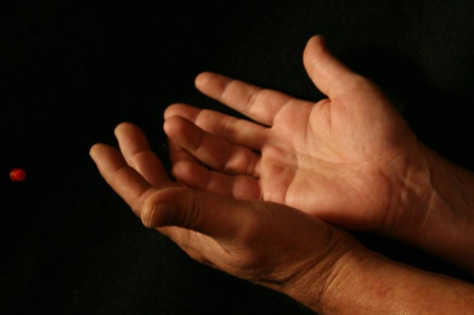
The Positive Influence of Celebrities
With so much negative media attention, some may have a difficult time imagining that celebrities contribute in a positive way to society.
Some will change their minds, however, when they visit the website linked below:
Look to the Stars

Slide 14
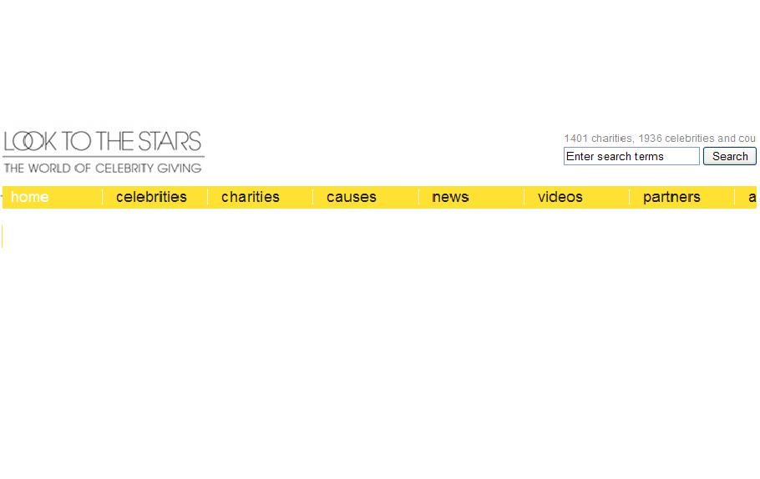
Look to the Stars
Spend some time browsing the website. At the top, look through both the celebrities and charities:
Look to the Stars

Slide 15
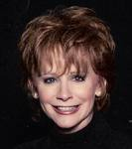
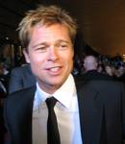
Choose Your Favorites
After you have browsed the website, choose ten of your favorite celebrities.
Record the celebrities’ names in the provided chart: “Celebrity Charities Browsing”

Slide 16
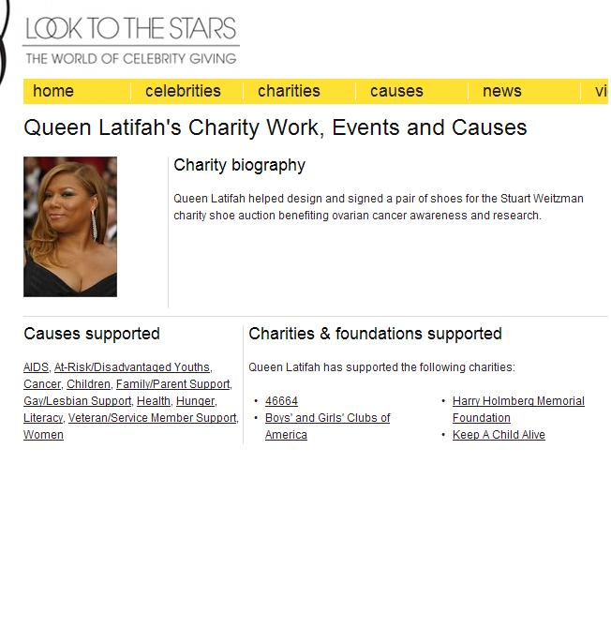
Browse their Charities
Once you have recorded the ten celebrities that caught your interest, browse their charities.
Then, write down one charity per celebrity on your chart.

Slide 17
Charity Recipients
In the third column of the chart, write a 1-2 sentence description of the charity or foundation and who it supports.

Slide 18
Celebrity/Sports Star | Foundation or charity he/she supports | Description of the foundation or charity | URL (website) of the foundation or charity
Ex: Red Hot Chili Peppers | Unite the United | The mission of this foundation is to encourage music artists to help change communities that need positive influences. The foundation raises funds to donate to small town organizations that make a difference in the national community (for ex: Boys and Girls Club) | http://www.unitethe united.org/
1.
2.
3.
4.
Write your chosen celebrities here!
Describe the charity here!
What charity does your celebrity support?

Slide 19
Celebrities in the Community
Watch the following two clips featuring Madonna (Raising Malawi) and Robin Williams (St. Jude’s Hospital):

Slide 20
Similarities and Differences
What was similar between those two video clips?
What was different?
How do those two celebrities feel about the charity they are supporting?

Slide 21
Your Pick…
Now that you have thoroughly examined Look to the Stars, choose two celebrity/charity duos that you would be interested in researching.
On the back of your worksheet, note your choices and then provide a one-sentence explanation for your choice.
(your choice may be based on the celebrity, the charity, or the people the charity supports)

Slide 22
Tomorrow…
Charity Research!

Slide 23
Credits
Produced by Kate Walters
Worksheet created by Kate Walters
Photographs provided by Google Images and Flickr via Creative Commons
Music provided by artists on Jamendo via Creative Commons
Videos provided by YouTube

Slide 24
Works Cited
“Chris Brown Talks about Rihanna Beating on MTV News.” Youtube. 5 November 2009. MPG.
“Clinton Testify.” Youtube. November 2006. MPG.
Creative Commons. Creative Commons Co. July 2009. Web. 10 November 2009.
Goo Goo Cluster. “Whoops!” Goo Goo Cluster. 2006. MP3.
Kanchi. “Nasty Boy.” The Ducky Dog. 2008. MP3.
Lacroix, Pierre. “Sweet Child of Mine.” My Little One. 2008. MP3.

Slide 25
Works Cited
“Mark McGwire Senate Testimony.” Youtube. November 2007. MPG.
Prod, Miguel. “impronte digitali.” fuori quarantena. 2007. MP3.
Purcell, Steve and Myrlia Purcell. Look To the Stars. 2009. Web. 10 November 2009.
“Raising Malawi With Madonna.” Youtube. 6 November 2009. MPG.
Shine, Erica. “When Will it End.” I Will Wait for You. 2009. MP3.
“St. Jude Children’s Research Hospital Commerical – Robin Williams.” Youtube. 13 October 2009. MPG.

