Slide 1
Collaborative Lesson Plan Spanish IV – Spanish Artists
Kate Mills
Fall 2011
SLM 552

Slide 2
SLM Standards (AASL)
1.1.2. Candidates assess learner needs and design instruction that reflects educational best practice.
1.1.4. Candidates base twenty-first century skills instruction on student interest and learning needs and link it to the assessment of student achievement.
1.2.1. Candidates implement the principles of effective teaching and learning that contribute to an active, inquiry-based approach to learning.
1.2.2. Candidates make use of a variety of instructional strategies and assessment tools to design and develop digital-age learning experiences and assessments in partnership with classroom teachers and other educators
1.3.1. Candidates model, share, and promote effective principles of teaching and learning as collaborative partners with other educators.
1.4.2. Candidates demonstrate how to collaborate with other teachers to plan and implement instruction of the AASL Standards for the 21st Century learner and state student curriculum standards.
1.4.4. Candidates integrate the use of emerging technologies as a means for effective and creative teaching and to support P-12 students’ conceptual understanding, critical thinking, and creative processes.
3.2.3. Candidates facilitate access to information in print, non-print, and digital formats.
3.3.2. Candidates model and facilitate the effective use of current and emerging digital tools to locate, analyze, evaluate, and use information resources to support research, learning, creating and communicating in a digital society.

Slide 3
SLM Standards (FCPS)
LM 10.01.a. Follow an inquiry process for an assigned information need
LM 20.02. Determine and apply appropriate search strategies for various electronic resources
LM 30.01. Evaluate content within a source to meet the information need (readability, ease of understanding, fact or opinion, relevance to information inquiry)
LM 30.02.b. Record only succinct and relevant information
LM 30.03.c. Independently and accurately give credit to sources of information (citing all quoted, paraphrased, summarized, and/or manipulated recorded data/information)
LM 30.03.d. Use style manuals and citation generators to format entries correctly
LM 40.02. Apply critical thinking and problem solving strategies to meet the information need (draw conclusions and valid inferences, demonstrate divergent thinking, generate new questions, defend positions, apply information in a new situation or creative activity, analyze information to generate new ideas, compare/contrast)
LM 50.01.b. Present findings/conclusions using technology in a variety of formats (computers, mp3 devices, document cameras, microphone and speaker, data projector)

Slide 4
Spanish Content Standards
5.2 Lifelong Learner: Develop an appreciation for the Fine Arts
5.2.1.Recognize sources of artistic inspiration
5.2.2. Write and orally present information about artists
5.2.3. Discuss the work about important Latin American and Spanish figures in the visual arts

Slide 5
Collaborative lesson overview
Six Day Project (with additional time at home)
Students researched a famous Spanish artist or architect and wrote an analysis of the influences of the artist’s life on his/her artwork
Included
Preassessment
Degas Article
Art Interest Survey
Research component
Essay in Spanish
Speech in Spanish
Multimedia Accompaniment to Speech

Slide 6
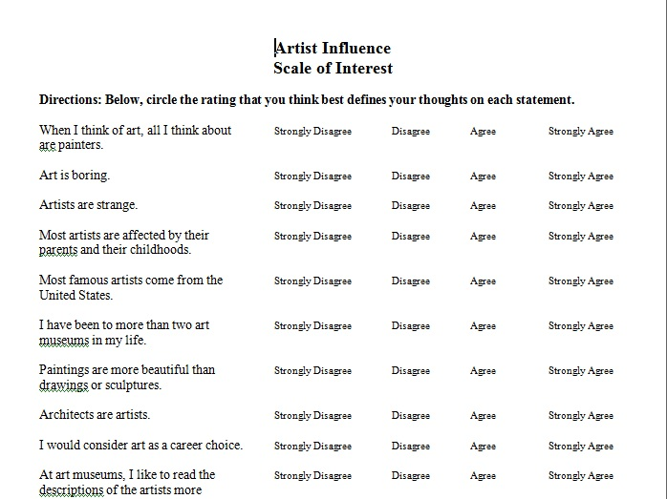
Pre-Assessment
Degas Article
Art Interest Survey
Please take it!

Slide 7
Research Component
One day of research instruction – October 20
My responsibility
Research Log
Digital Note-taker – Would it have been better?
Citations
Two days of independent research – October 24-25
Parenthetical Citations – October 26

Slide 8
Research/Database Instruction
Introduction to Recommended Databases:

Slide 9
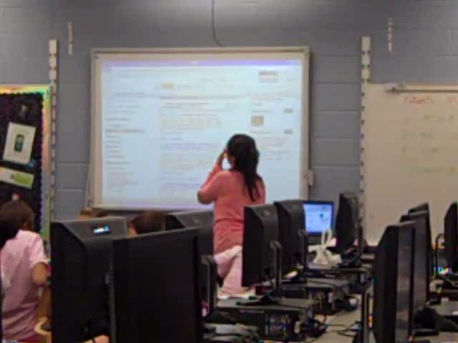
Research/Database Instruction, cont.
After Lunch…☺

Slide 10
Remainder of Library Time
Introduction of Writing Assignment – Bethany
To accompany Parenthetical Citation Lesson
Multimedia Options
Ms. Brown’s Spanish Class Blog
Speech
Grading and Assessment (next slide)

Slide 11
Grading Co-assessment
Degas Article Response
Kate
Spanish Essay
Bethany
Presentation
Bethany
Research Log
Kate
Works Cited Page and In-Text Citations
Kate
See sample in your collection of hand-outs

Slide 12
Student Presentations
What went right:
Multimedia projects
Student Understanding of Speech Requirements
What went wrong:
Length
Transfer of Paper to Speech
What could the school librarian have done?
Lesson on speaking strategies
Writing workshop on paper to speech transfer
Next three slides – Samples of student presentations

Slide 13
Student Presentation #1

Slide 14
Student Presentation #2

Slide 15
Student Presentation #3

Slide 16
Student Evaluations
Students liked
The concept of the project
The opportunity to choose their own artist
The creation of the multimedia
The ease of research
Students felt we needed to improve
The length of time to complete the project
The instruction on parenthetical citations
My ability to be in the classroom
Spanish – English translation -?!
Instructions on how to give the speech

Slide 17
What Did I Learn?
School librarians are perfectly capable of collaborating with a world languages teacher, despite the language barrier ☺
My pre-assessment article was incredibly effective
I need to be with the class throughout the entire project in order to be a fully collaborative partner
The time in class for this project was perfectly sufficient; the time out of class was not.
I would have liked to have been present during the student presentations.
The time spent determining best databases and establishing the presence of sources for each artist was worth my time but does not necessarily teach the students how to hone/change research topics and questions during the research process

